Slide 1


INSTITUTE FOR ADVANCED COMPUTING ANDSOFTWARE DEVELOPMENT (IACSD), AKURDI, PUNE
Documentation On
Online Resort Booking System
PG-DAC March 2023
Submitted By:
Group No: 50
Roll No. 233094
233114
Name:
Shubham Kamble Shivanand Zunjare
Mrs. Geeta Madam
Project Guide
Mr. Rohit Puranik
Centre Coordinator

Slide 2
IACSD
SMS.com
ABSTRACT
This project is a web-based resort booking system for an existing resort. The project objective is to manage the bookings from web platform.
The system is an attempt to provide the advantages of online bookings and managing data of the resort. It helps to check for available rooms/events and books room/event from anywhere through internet by using a website device.
This will be beneficial to all the members who travel. This application will travel worldwide and any members will have an access to it. Understanding the needs of the customer and to overcome the visit physically to the resort and check for the available booking. So to make it online which will be feasible and flexible and try to make it user friendly.

Slide 3
IACSD
SMS.com
ACKNOWLEDGEMENT
I take this occasion to thank God, almighty for blessing us with his
grace and taking our endeavor to a successful culmination. I extend my sincere
and heartfelt thanks to our esteemed guide, Mrs.Geeta Mam for providing me with the right guidance and advice at the crucial juncture sand for showing me the right way. I extend my sincere thanks to our respected Centre Co-Ordinator Mr. Rohit Puranik, for allowing us to use the facilities available. I would like to thank the other faculty members also, at this occasion. Last but not the least, I would like to thank my friends and family for the support and encouragement they have given me during the course of our work.
Shubham K (223094)
Shivanand Z (223114)

Slide 4
IACSD
SMS.com
Table of Contents
ABSTRACT................................................................................................................................... 1
ACKNOWLEDGEMENT............................................................................................................ 2
INTRODUCTION......................................................................................................................... 6
FEATURES ................................................................................................................................... 6
1.1 PROJECT OBJECTIVE................................................................................................... 7
1.2 PROJECT OVERVIEW ................................................................................................... 7
1.3 PROJECT SCOPE ................................................................................................................. 8
1.4 STUDY OF THE SYSTEM ................................................................................................... 8
1.4.1 MODULES .................................................................................................................... 8
SYSTEM ANALYSIS................................................................................................................. 14
2.1 EXISTING SYSTEM ........................................................................................................... 14
2.2 PROPOSED SYSTEM ......................................................................................................... 14
2.3 SYSTEM REQUIREMENT SPECIFICATION................................................................ 14
2.3.1 GENERAL DESCRIPTION..................................................................................... 14
2.3.2 SYSTEM OBJECTIVES ........................................................................................... 15
2.3.3 SYSTEM REQUIREMENTS................................................................................... 15
SYSTEM DESIGN...................................................................................................................... 17
3.1 INPUT AND OUTPUT DESIGN ........................................................................................ 17
3.1.1 INPUT DESIGN ........................................................................................................ 17
3.1.2 OUTPUT DESIGN .................................................................................................... 17
DATABASE DESIGN ................................................................................................................ 19
3.2 DATABASE........................................................................................................................... 19
3.3 SYSTEM TOOLS ................................................................................................................. 19
3.3.1 FRONT END.............................................................................................................. 19
3.3.2 BACKEND ................................................................................................................. 19

Slide 5
IACSD
SMS.com
0 LEVEL DFD........................................................................................................................... 20
1 LEVEL DFD FOR USER........................................................................................... .……….21
1 LEVEL DFD FOR ADMIN .................................................................................................... 22
E-R DIAGRAM........................................................................................................................ 23
CLASS DIAGRAM..................................................................................................................... 24
TABLE STRUCTURE ............................................................................................................... 25
PROJECT DIAGRAMS............................................................................................................. 28
CONCLUSION ........................................................................................................................... 41
REFERENCES............................................................................................................................ 42

Slide 6
IACSD
SMS.com
LIST OF FIGURES
FIGURE 1: USER ACTIVITY DIAGRAM---------------------------------------------------------------10
FIGURE 2: ADMIN ACTIVITY DIAGRAM ------------------------------------------------------------12
FIGURE 3: 0 LEVEL DFD ----------------------------------------------------------------------------------- 20
FIGURE 4: 1 LEVEL DFD FOR USER-------------------------------------------------------------------- 21
FIGURE 5: 1 LEVEL DFD FOR ADMIN----------- -------------------------------------------------------22
FIGURE 6: E-R DIAGRAM ---------------------------------------------------------------------------------- 23
FIGURE 7: CLASS DIAGRAM ---------------------------------------------------------------------------- 24
FIGURE 8: TABLE STRUCTURE-- ----------------------------------------------------------------------- 25
FIGURE 9: PROJECT DIAGRAMS ----------------------------------------------------------------------- 28

Slide 7
IACSD
SMS.com
INTRODUCTION
The web based Online room/event booking system, where customers can easily
explore resort websites and book their preferred type of room, whether it be tent or
superior, or Executive for a specific date and number of guests. The system also allows users to
choose how many rooms they want to book and requires them to login before completing
their booking.
This system also helps admin to efficiently manage their bookings and view
guest details, including which rooms they have booked. Managers can also check room/event booking details, also can check the enquiry coming for customers even
cancel enquiry if necessary.
Overall, this Online Resort Booking System is a comprehensive solution that streamlines
the booking process for both customers and hotel admin, making the entire experience
more convenient and efficient for everyone involved.
Features: -
Separate login for user and admin.
Easy to add and delete the booking of room/event by the user.
Easy to generate invoice for each booking by the user.
Easy to check the booking details by user.
Admin can check the booking/event details booked by the user.
Admin can check check and delete the enquiry.

Slide 8
IACSD
SMS.com
1.1 PROJECT OBJECTIVE
The online Resort Booking System (Web Application) for rooms and events is intended to provide complete solution for Consumers through a single Gateway using internet. It will enable customers to browse through online resort booking web application and books the resort online without visiting the booking shop physically.
1.2 PROJECT OVERVIEW
The application designed into three modules first one is the secretary who has full access to the application .Second one is the flat owner who can manages tasks that are all related to his/her flat only. Third module is security guard who can only add or delete visitor who visited to the society. Secretary can add or delete or update the data of flat owner or workstaff.
Secretary gives limited access of this system to flat owner and security guard. The data related with the flat details and its owner stored by secretary on database through system. Secretary is able to generate maintenance bill of a flat which can be viewed by that flat owner only. Secretary circulates the notice using the system and this notice can be viewed by all flat owners. Flat owner may add tenant for his/her flat and can save tenants details on database through the system. Flat owner may raise the complaint through the system which can be viewed and solved by secretary and its status get changed from pending to completed. Flat owner can add his vehicle details on database through the system.

Slide 9
IACSD
SMS.com
PROJECT SCOPE
This System allows customer to book the room as per their requirements also book the resort for different events for adding or removing from catalogue based on their availability. Customer will be able to review booking history and may able to cancel booking. The System will be able to show over all booking for different customer through Customized dashboard.
STUDY OF THE SYSTEM
MODULES:
The system after careful analysis has been identified to be presented with the following modules and roles.
The modules involved are:
User
Admin
1.4.1.1 User:
The booking as the "user". To ensure the security of the system, it is necessary for
the user to first complete the registration process before being able to log in. Once the
registration process is complete, the user can log in using their registered email ID and
password.

Slide 10
IACSD
SMS.com
In the event that the user forgets their password, our system provides a convenient
password reset feature. In order to reset the password, the user must first enter the email and adhar card number and reset the password. This added layer of security helps to safeguard the user's account and prevent unauthorized access.
1.4.1.2 Admin:
Upon logging in, the admin will be directed to the admin interface, the
admin is provided with an overview of the hotel's booking status, including the number
of rooms that have been booked and the number of deluxe and non-deluxe rooms that
have been booked.
In addition, the manager can view individual bookings, which include details such as the
check-in and check-out dates, room type, number of guests, and booking ID.
Furthermore, the manager can view a list of all rooms and check which guests are
currently staying in each room. Overall, our booking management portal offers a
comprehensive solution for efficient hotel management.
Admin can also be check the enquiry coming from different customer and manage the enquiry.

Slide 11
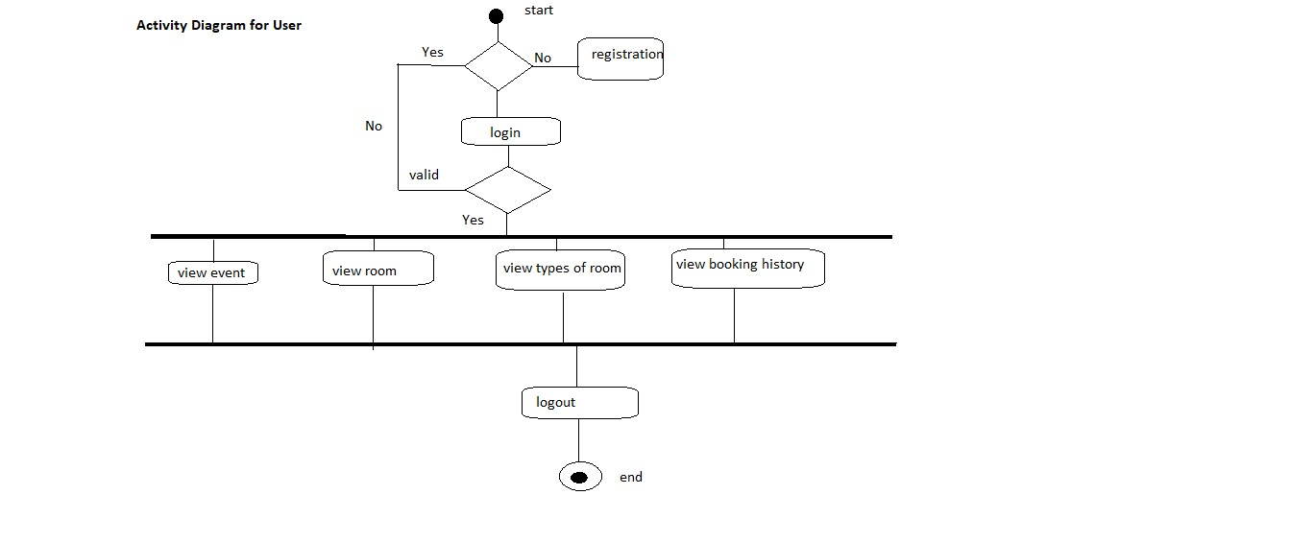
IACSD
SMS.com
Figure 1 User Activity Diagram

Slide 12
IACSD
SMS.com
View Event
User can select and add the event.
View Room
User can select the type of room and add the room.
View Types of Room
User can select the room from the available type of room.
Delete booking
User can delete the bookings.
View Booking History
User can view the booking history.

Slide 13
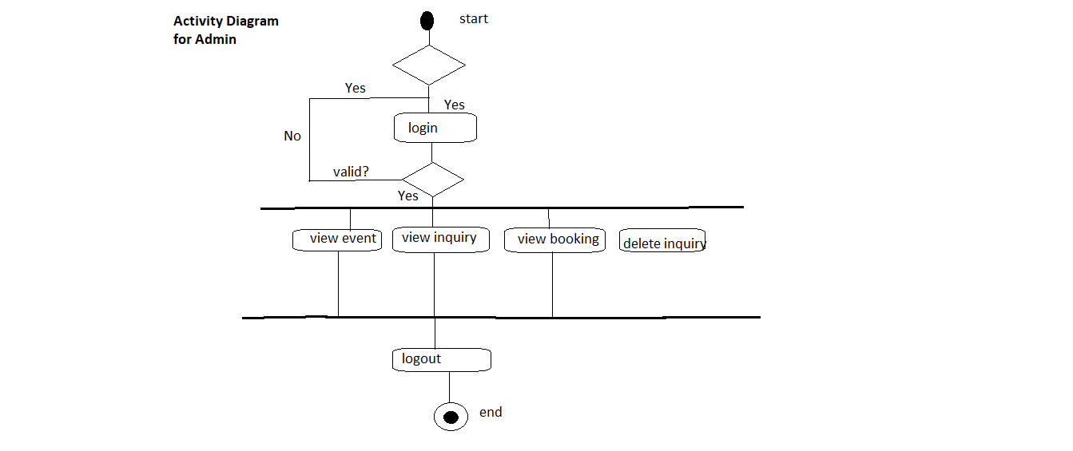
IACSD
SMS.com
Figure 2 Admin Activity Diagram

Slide 14
IACSD
SMS.com
View Room Booking details
Admin can check the all the room booking details.
View Event Booking details
Admin can check the all the event booking details.
View Customer details
Admin can check the all customer details.
View Enquiry details
Admin can check the all the enquiry details coming from different customer.
Delete the Enquiry
Admin can delete the enquiry details if necessary.

Slide 15
IACSD
SMS.com
SYSTEM ANALYSIS
System analysis is the process of gathering and interpreting facts, diagnosing problems, and using the information to recommend improvements on the system. System analysis is a problem-solving activity that requires intensive communication between the system users and system developers.
System analysis or study is an important phase of any system development process. The system is viewed as a whole, the inputs are identified, and the system is subjected to close study to identify the problem areas. The solutions are given as a proposal. The proposal is reviewed on user request and suitable changes are made. This loop ends as soon as the user is satisfied with the proposal.
EXISTING SYSTEM
The current system for resort booking is maintain the register notebook in the resort and we have to personally visit the resort for enquiry or to book the room/event.
It is less user-friendly.
User need to physically approach to the resort.
Resort admin need to maintain the physical register to maintain the customer booking records also maintain the register notebook for the customer details.
It is a time-consuming process
Not in reach of distant users.
PROPOSED SYSTEM
The proposed system provides friendly user interface to every customer. This application will help all the people which will provide them visibility and smooth functioning. This will be beneficial to all the people who travel. This application will travel worldwide and any members will have an access to it. Understanding the needs of the customer and to overcome the manual work of the documentation and make it online which will be feasible and flexible and try to make it user friendly. Web-platform means that the system will be available for access 24/7 except when there is a temporary server issue which is expected to be minimal.
SYSTEM REQUIREMENT SPECIFICATION
2.3.1 GENERAL DESCRIPTION

Slide 16
IACSD
SMS.com
Product Description:
The online resort booking System allows customer to login with their own account and get available booking details regarding rooms and event. Resort booking System is the website portal to reduce physical work and allows the check or book the rooms from any where.
Problem Statement:
Time-Consuming Booking Process:
Traditional Methods are Time Consuming.
Inflexible Payment Options:
insecure or inflexible payment.
Limited Access to Information:
Offline booking methods limit users' access to comprehensive information.
Lack of Real-Time Updates:
Updates may vary.
SYSTEM OBJECTIVES
To provide a Web site for resort booking system for an existing resort.
SYSTEM REQUIREMENTS
NON-FUNCTIONAL REQUIREMENTS
EFFICIENCY REQUIREMENT
When user and admin visits system it should access in an efficient manner.
RELIABILITY REQUIREMENT
The system should provide a reliable environment to user and admin. All data should be store on server.
USABILITY REQUIREMENT
The Web application is designed for user friendly environment and ease of use.
IMPLEMENTATION REQUIREMENT

Slide 17
IACSD
SMS.com
Implementation of the system using React in front end with Spring Boot as back end and it will be used for database connectivity. And the database part is developed by MySQL. Responsive web designing is used for making the website compatible for any type of screen.
v. DELIVERY REQUIREMENT
The whole system is expected to be delivered in four months of time with a weekly Evaluation by the project guide.
FUNCTIONAL REQUIREMENTS
Functional Requirement
Login Portal for user and admin.
Admin has all control over the functionality like remove, view, update details of customer.
Admin could view all the room and event booking details also customer details and enquiry coming from different anonymous user.
User should view only user interface
User can book rooms or event as per their requirement
Anonymous user capable to ask for the enquiry.

Slide 18
IACSD
SMS.com
SYSTEM DESIGN
System design is the solution for the creation of a new system. This phase focuses on the detailed implementation of the feasible system. Its emphasis on translating design. Specifications to performance specification. System design has two phases of development.
Logical Design
Physical Design
During logical design phase the analyst describes inputs (sources), outputs(destinations), databases (data store) and procedures (data flows) all in a format that meets the user requirements. The analyst also specifies the needs of the user at a level that virtually determines the information flow in and out of the system and the data resources. Here the logical design is done through data flow diagrams and database design. The physical design is followed by physical design or coding. Physical design produces the working system by defining the design specifications, which specify exactly what the candidate system must do. The programmers write the necessary programs that accept input from the user, perform necessary processing on accepted data and produce the required report on a hard copy or display it on the screen.
INPUT AND OUTPUT DESIGN
INPUT DESIGN:
Input design is the link that ties the information system into the world of its users. The input design involves determining the inputs, validating the data, minimizing the data entry and provides a multi-user facility. Inaccurate inputs are the most common cause of errors in data processing. Errors entered by the data entry operators can be controlled by input design. The user-originated inputs are converted to a computer-based format in the input design. Input data are collected and organized into groups of similar data. Once identified, the appropriate input media are selected for processing. All the input data are validated and if any data violates any conditions, the user is warned by a message. If the data satisfies all the conditions, it is transferred to the appropriate tables in the database. In this project the student details are to be entered at the time of registration. A page is designed for this purpose which is user friendly and easy to use. The design is done such that users get appropriate messages when exceptions occur.
OUTPUT DESIGN:
Computer output is the most important and direct source of information to the user. Output design

Slide 19
IACSD
SMS.com
is a very important phase since the output needs to be in an efficient manner. Efficient and intelligible output design improves the system relationship with the user and helps in decision making. Allowing the user to view the sample screen is important because the user is the ultimate judge of the quality of output. The output module of this system is the selected notifications.

Slide 20
IACSD
SMS.com
DATABASE DESIGN
DATABASE
Databases are the storehouses of data used in the software systems. The data is stored in tables inside the database. Several tables are created for the manipulation of the data for the system. Two essential settings for a database are
Primary key - the field that is unique for all the record occurrences
Foreign key - the field used to set relation between tables
Normalization is a technique to avoid redundancy in the tables.
SYSTEM TOOLS
The various system tools that have been used in developing both the front end and the back end of the project are being discussed in this chapter.
FRONT END:
React is a library which is developed by Facebook are utilized to implement the frontend. React (also known as React.js or ReactJS) is a free and open-source front-end JavaScript library for building user interfaces or UI components. It is maintained by Facebook and a community of individual developers and companies. React can be used as a base in the development of single page or mobile applications. However, React is only concerned with state management and rendering that state to the DOM, so creating React applications usually requires the use of additional libraries for routing, as well as certain client-side functionality.
BACKEND:
The back end is implemented using MySQL which is used to design databases.
MySQL:
MySQL is the world's second most widely used open-source relational database management system (RDBMS). The SQL phrase stands for Structured Query Language.
Spring-Boot:

Slide 21
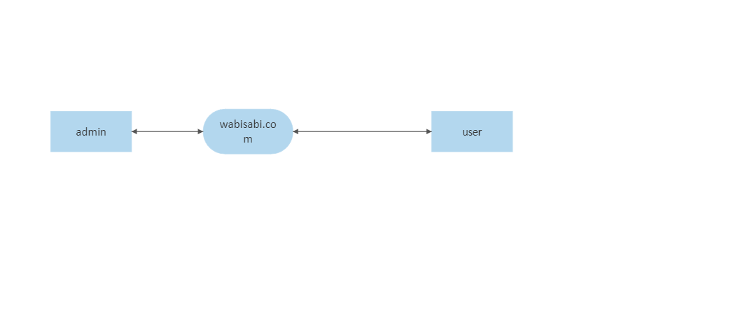
IACSD
SMS.com
This is used to connect MYSQL and fetch data from database and store the data in database. The Spring Framework is an application framework and inversion of control container for the Java platform. The framework's core features can be used by any Java application, but there are extensions for building web applications on top of the Java EE (Enterprise Edition) platform. Although the framework does not impose any specific programming model, it has become popular in the Java community as an addition to the Enterprise JavaBeans (EJB) model. The Spring Framework is Open-source Framework.
0 Level DFD
Figure 4 0 Level DFD

Slide 22
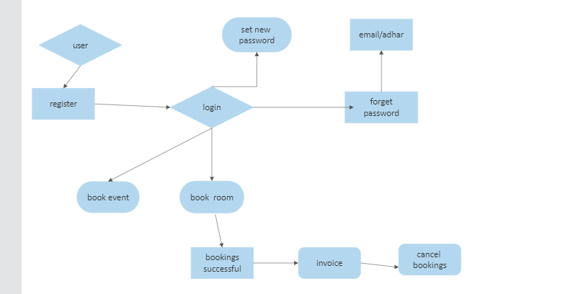
IACSD
SMS.com
1Level DFD for User
Figure 5 1 Level DFD for User

Slide 23
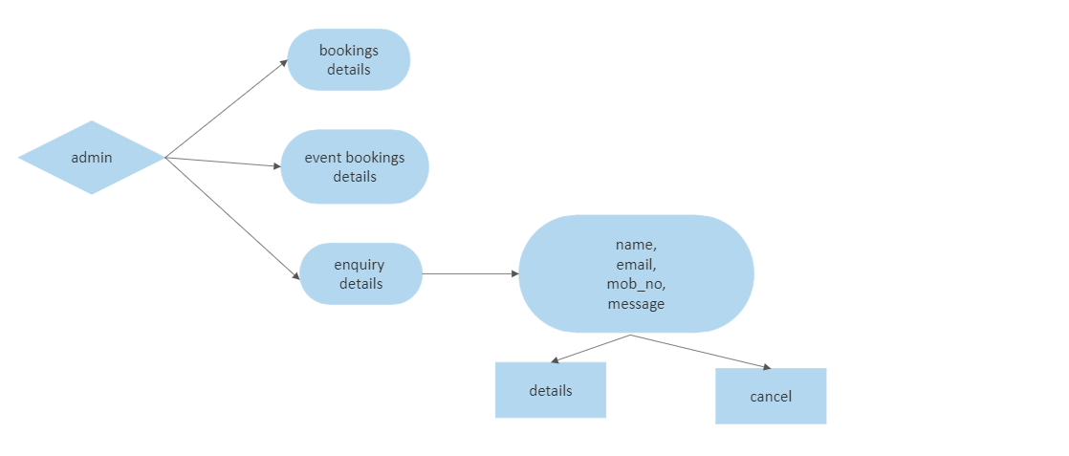
IACSD
SMS.com
1 Level DFD for Admin
Figure 6 1 Level DFD for Admin

Slide 24
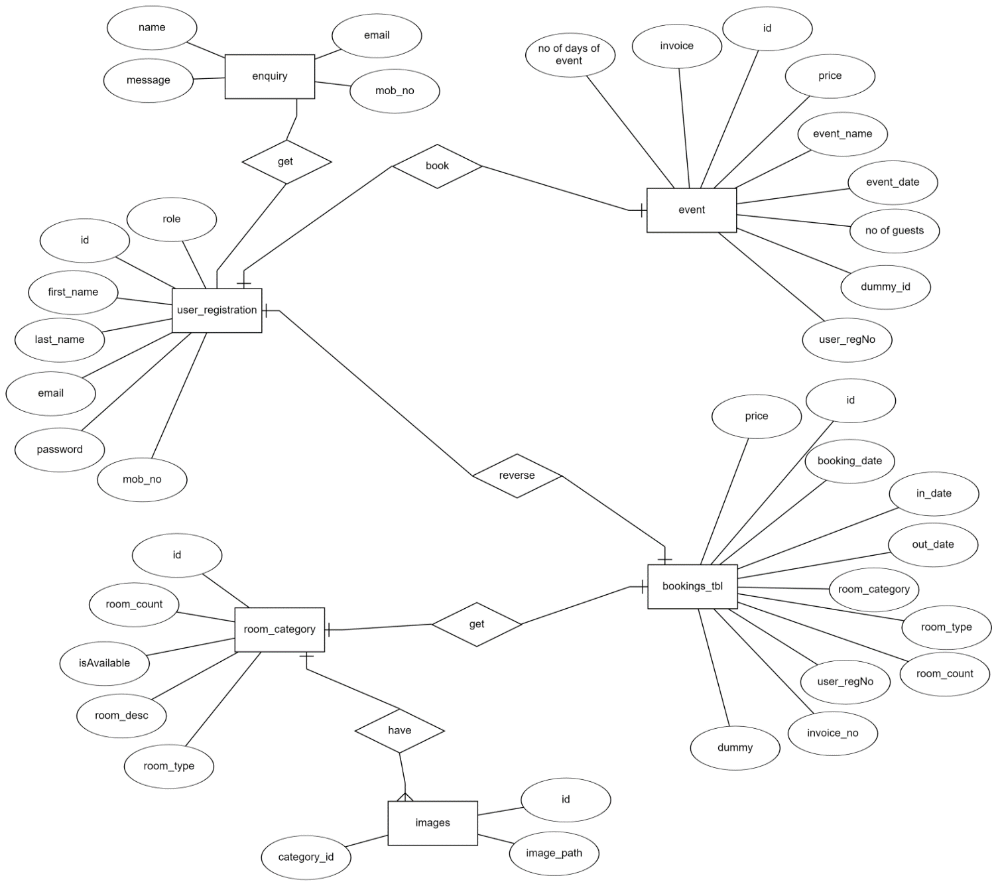
IACSD
SMS.com
E-R Diagram:
Figure 8 E-R Diagram

Slide 25
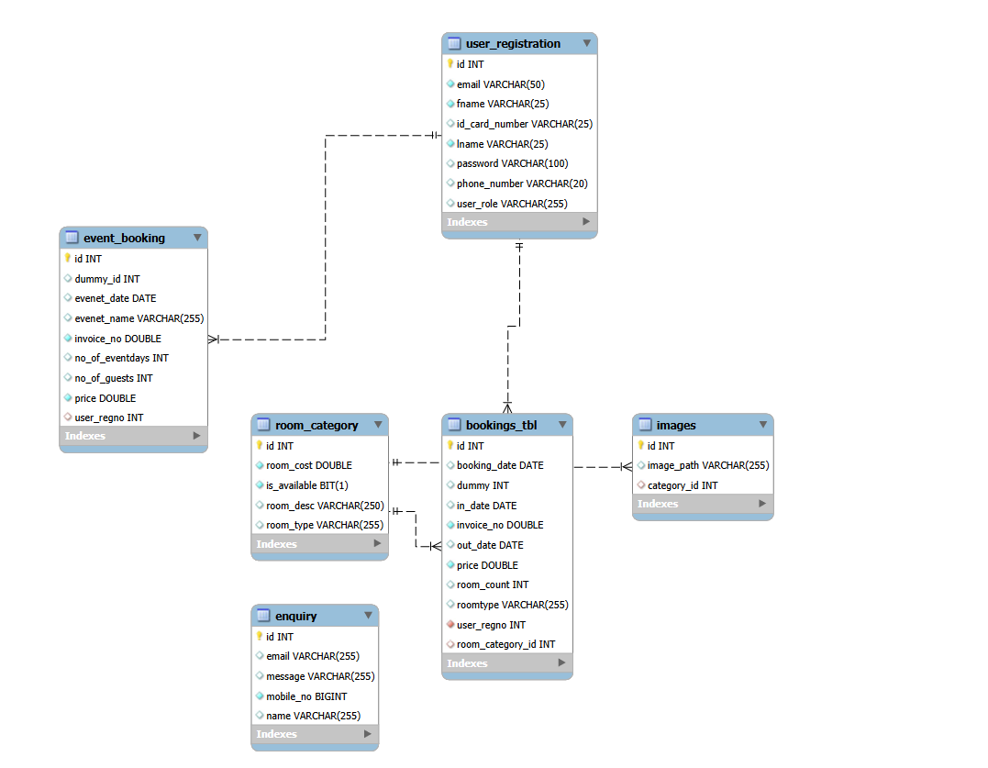
IACSD
SMS.com
Class Diagram
Figure 9 Class Diagram

Slide 26
IACSD
SMS.com
TABLE STRUCTURE:
1)Bookings Table
SR No. | Name(Value) | Type(data type | Size
1 | Id | int | 4
2 | Booking_date | date | 8
3 | Dummy | int | 4
4 | In_date | date | 6
5 | Invoice_no | double | 8
6 | Out_date | date | 6
7 | Price | double | 8
8 | Room_count | int | 4
9 | Roomtype | varchar | 255
10 | User_regno | int | 4
11 | Room_category_id | int | 4
2)Enquiry
SR No. | Name(Value) | Type(data type | Size
1 | Id | int | 4
2 | Email | varchar | 255
3 | Message | varchar | 255
4 | Mobile No | bigint | 4
5 | Name | varchar | 255

Slide 27
IACSD
SMS.com
3)Event Booking
SR No. | Name(Value) | Type(data type | Size
1 | Id | int | 4
2 | Dummy id | int | 4
3 | Event data | Date | 6
4 | Event name | varchar | 255
5 | Invoice_no | double | 8
6 | No of eventdays | int | 4
7 | No of Guests | int | 4
8 | Price | double | 8
9 | User RegNo | int | 255
4)Images
SR No. | Name(Value) | Type(data type | Size
1 | Id | int | 4
2 | Image Path | varchar | 255
3 | Room category id | int | 4

Slide 28
IACSD
SMS.com
5)Room Category
SR No. | Name(Value) | Type(data type | Size
1 | Id | int | 4
2 | Room cost | double | 8
3 | IsAvailable | Bit | 1
4 | Room desc | varchar | 250
5 | Room type | varchar | 255
6)User Registration
SR No. | Name(Value) | Type(data type | Size
1 | Id | int | 4
2 | Email | varchar | 50
3 | First Name | varchar | 25
4 | Id Card Number | varchar | 25
5 | Last Name | varchar | 25
6 | Password | varchar | 100
7 | Phone Number | varchar | 20
8 | User Role | varchar | 255

Slide 29
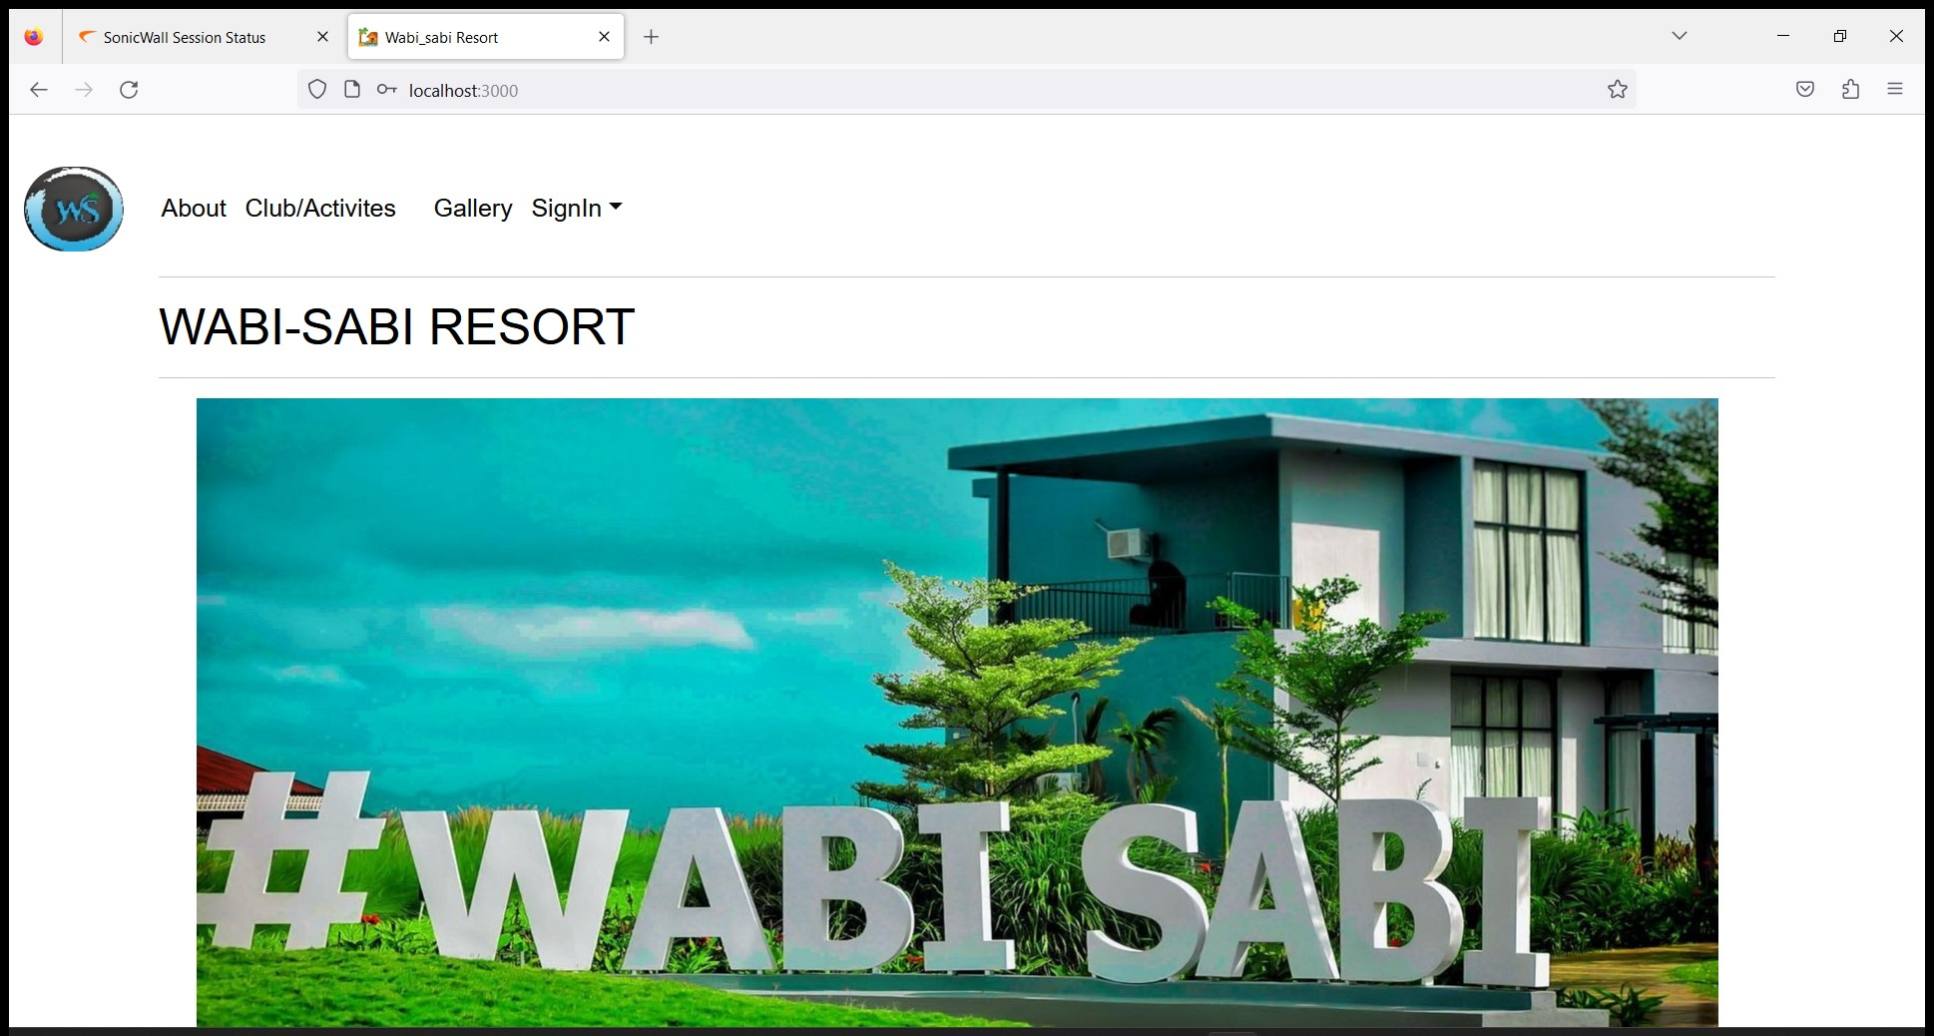
IACSD
SMS.com
PROJECT DIAGRAMS
Home Page :

Slide 30
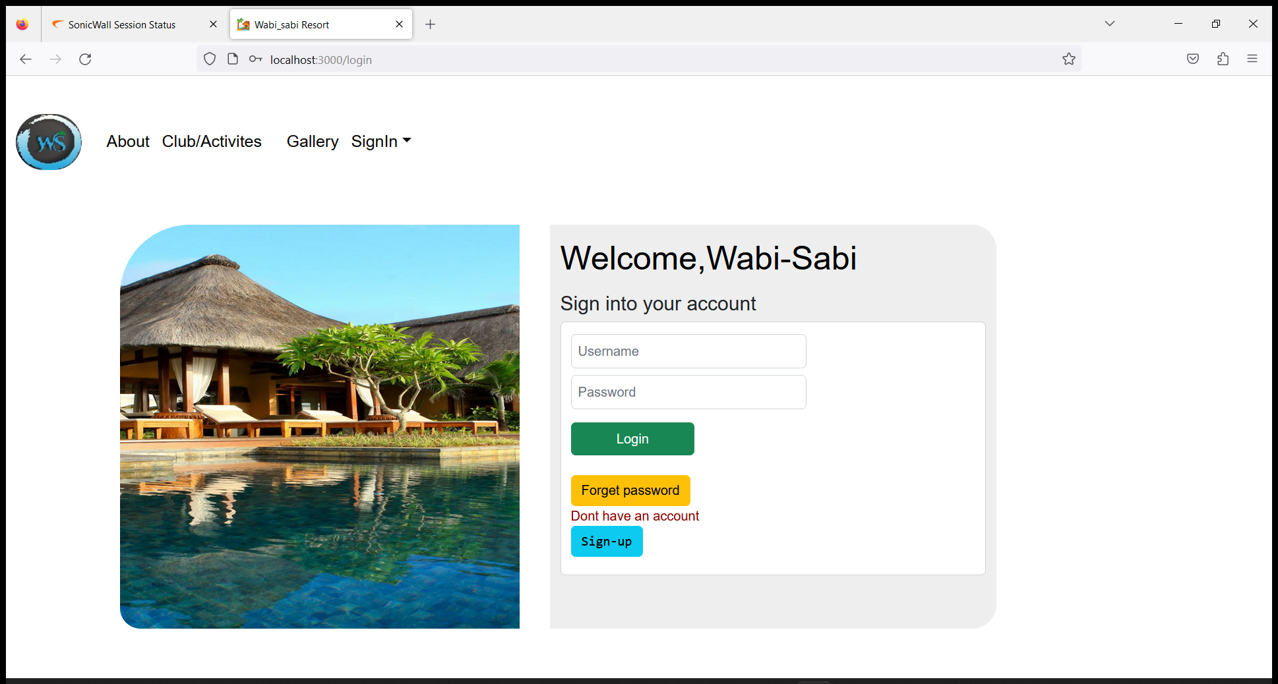
IACSD
SMS.com
Customer Login Page :

Slide 31
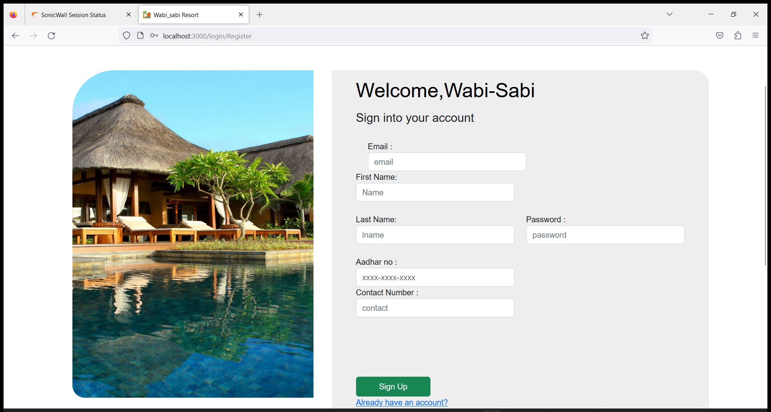
IACSD
SMS.com
User Registration:

Slide 32
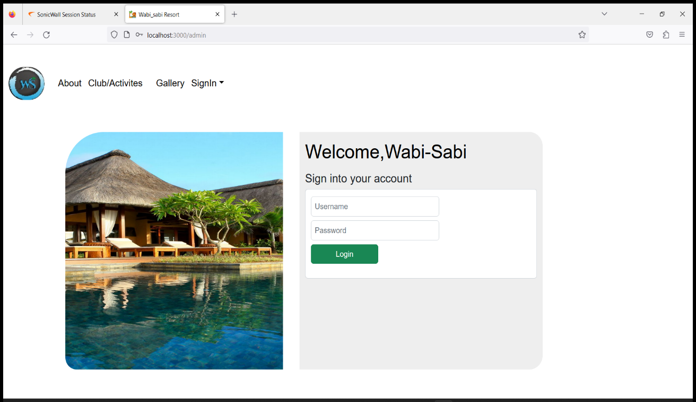
IACSD
SMS.com
Admin Login :

Slide 33
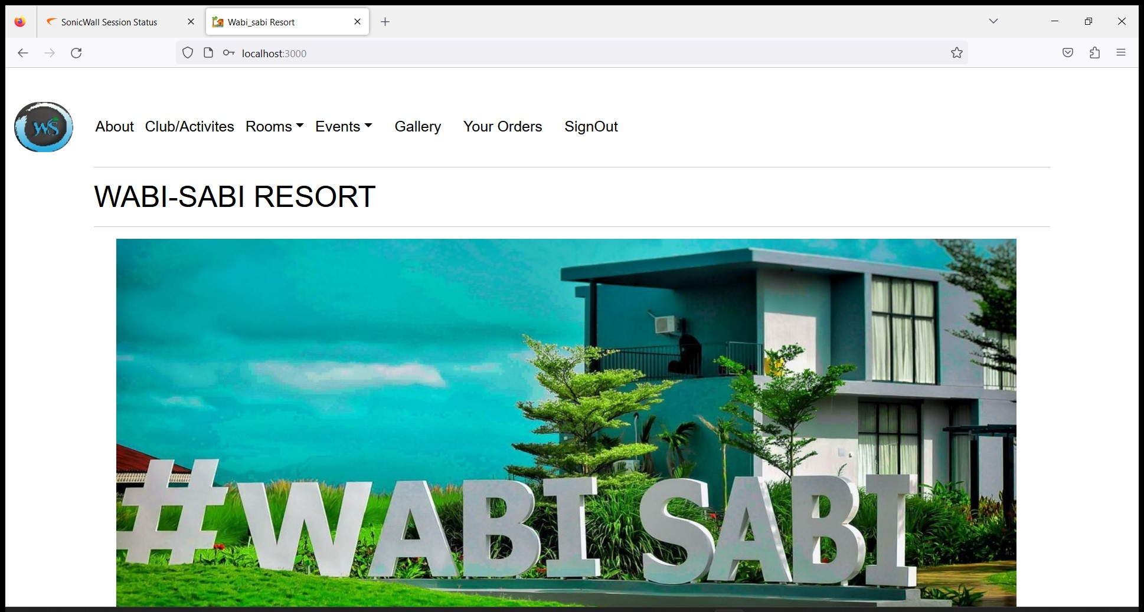
IACSD
SMS.com
User Interface

Slide 34
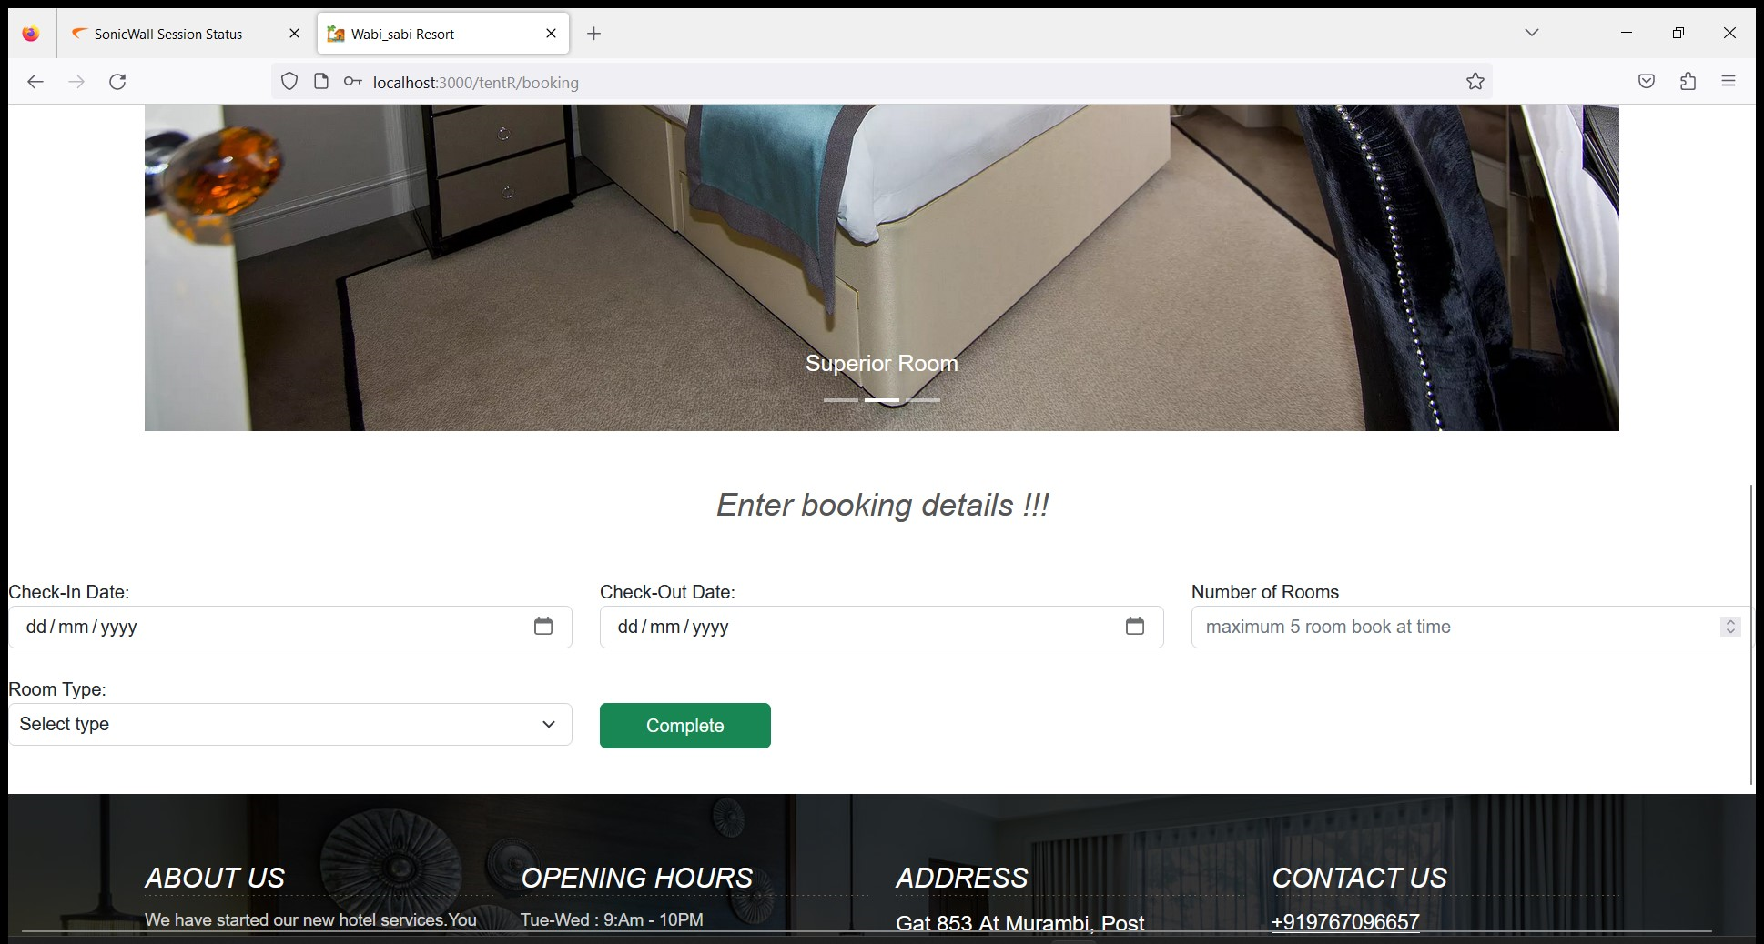
IACSD
SMS.com
Booking Room:

Slide 35
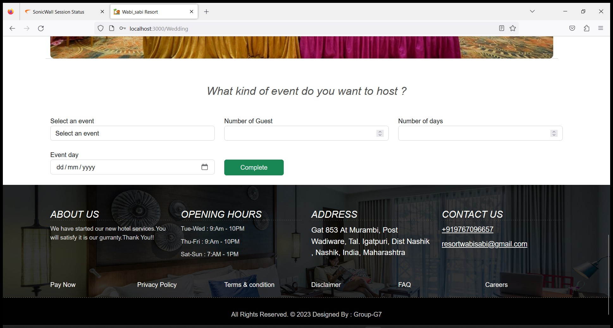
IACSD
SMS.com
Book Event :

Slide 36
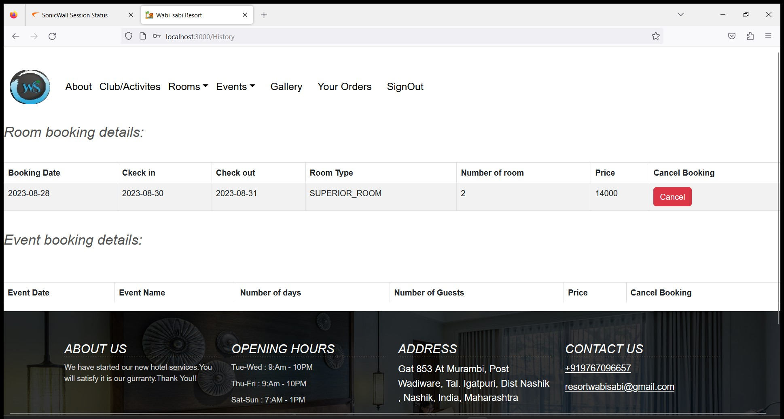
IACSD
SMS.com
Room/Event Details:

Slide 37
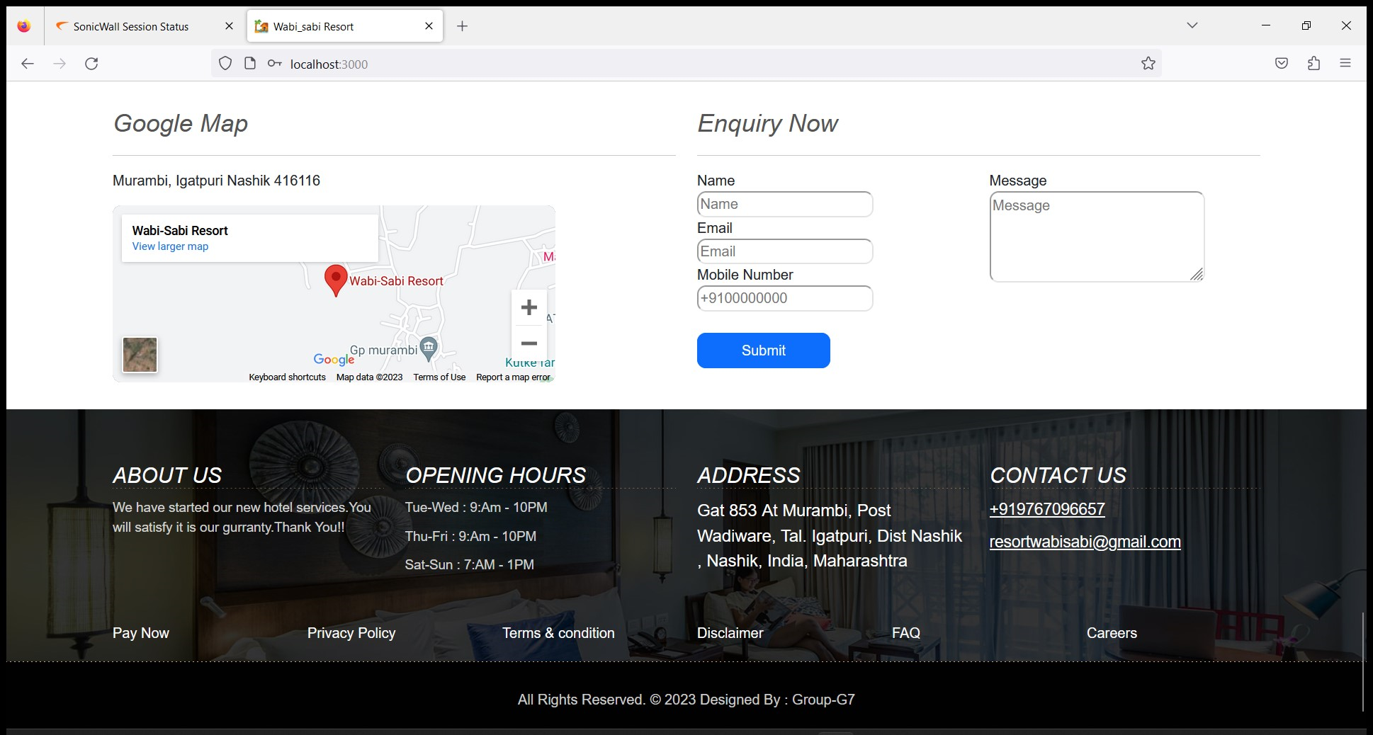
IACSD
SMS.com
Enquiry Now :

Slide 38

IACSD
SMS.com
Admin Interface :

Slide 39
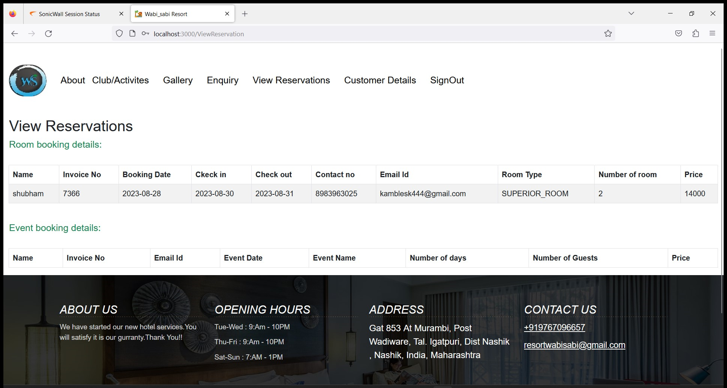
IACSD
SMS.com
View Reservations :

Slide 40
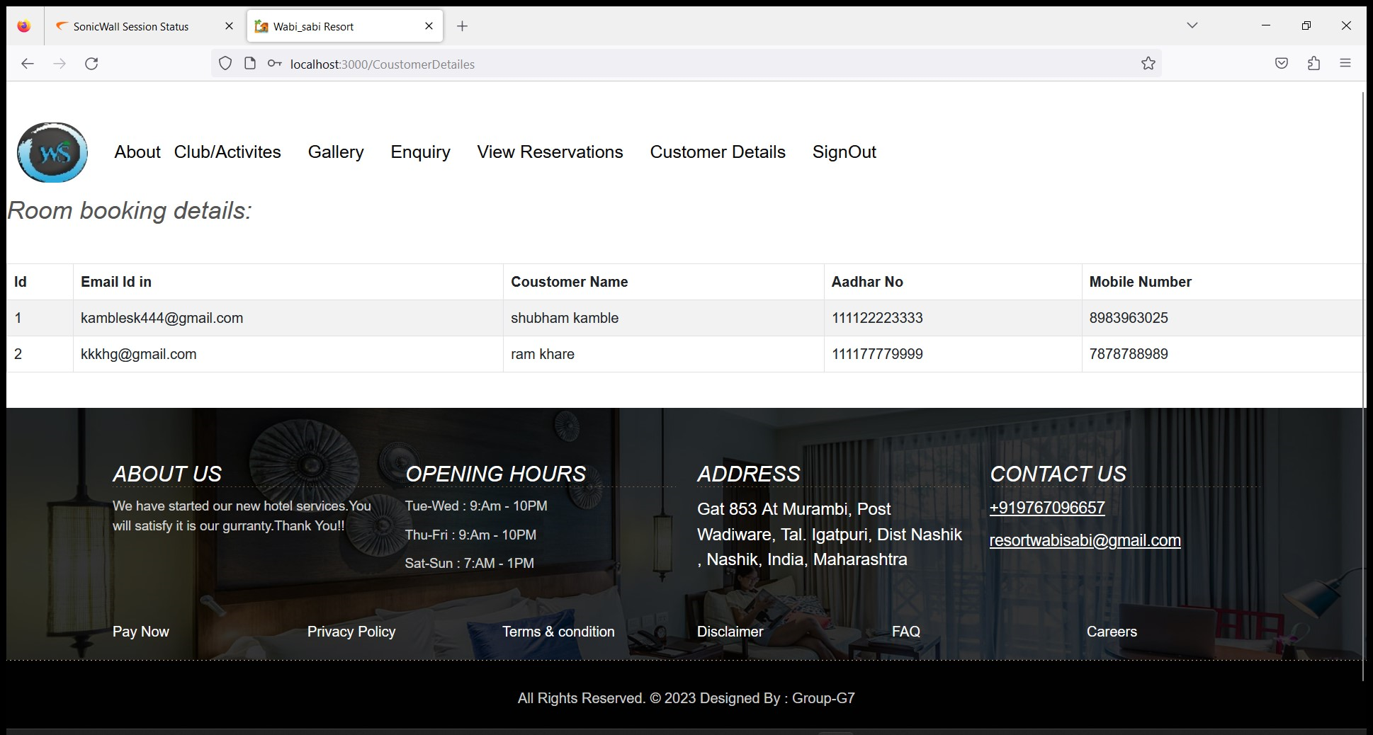
IACSD
SMS.com
Room Booking Details :

Slide 41
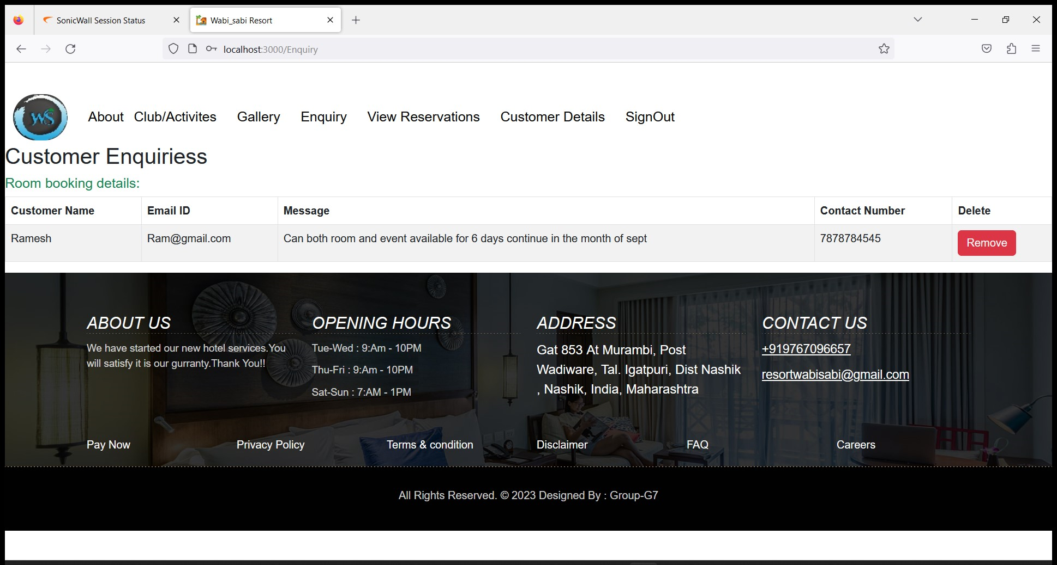
IACSD
SMS.com
Customer Enquiries :

Slide 42
IACSD
SMS.com
CONCLUSION
The project entitled Online Resort Booking System was completed successfully.
1.User-Centric Solution:
Our platform places users at the forefront, offering intuitive features that streamline the booking process and enhance user engagement
2. Seamless Booking Experience:
Users can now enjoy a seamless booking experience, from searching and filtering rooms to secure payment transactions.
3. Potential for Growth:
The insights gained from user engagement and feedback provide valuable direction for future enhancements and updates to the platform.
The system has been developed with much care and free of errors and at the same time it is efficient and less time consuming. The purpose of this project was to develop a web application for online resort bookings. This project helped us in gaining valuable information and practical knowledge on several topics like designing web pages using React.js, usage of responsive templates, and management of database using MySQL. This project has given us great satisfaction in having designed an application which can be implemented to any nearby shops or branded shops selling various kinds of products by simple modifications.
There is a scope for further development in our project to a great extent. A number of features can be added to this system in future like providing payment gateway for maintainace payment and maintain their records in dashboard

Slide 43
IACSD
SMS.com
REFERENCES
JavaScript Enlightenment, Cody Lindley-First Edition, based on JavaScript 1.5, ECMA-262,
Edition
Mc Graw Hill’s, Java: The complete reference 7thEdition, Herbert Scheldt
Complete CSS Guide, Maxine Sherrin and John Allsopp-O'ReillyMedia; September 2012
ONLINE REFERENCE
www.Google.com
www.w3school.com
www.javatpoint.com
www.stackoverflow.com
www.reactbootstrap.com
www.doc.spring.io/spring-framework.com
www.geekforgeeks.com
www.microsoftdoc.com
www.geeksforpratice.com

